Slide 1

Applied data science capstone
By - HARAN PRAGADEESH

Slide 2
INTRODUCTION / BUSINESS PROBLEM
London, the capital of England and the United Kingdom, is a 21st-century city with history stretching back to Roman times. At its centre stand the imposing Houses of Parliament, the iconic ‘Big Ben’ clock tower and Westminster Abbey, site of British monarch coronations. Across the Thames River, the London Eye observation wheel provides panoramic views of the South Bank cultural complex, and the entire city.
London is one of the most ethnically diverse cities in the world. A 2000 survey of school children reported there were over 300 languages spoken at home. At the 2011 census, London had a population of 8,173,941. Of this number 44.9% were White British. 37% of the population were born outside the UK, including 24.5% born outside of Europe
Toronto is the capital city of the Canadian province of Ontario. With a recorded population of 2,731,571 in 2016, it is the most populous city in Canada and the fourth most populous city in North America. The city is the anchor of the Golden Horseshoe, an urban agglomeration of 9,245,438 people (as of 2016) surrounding the western end of Lake Ontario, while the Greater Toronto Area (GTA) proper had a 2016 population of 6,417,516. Toronto is an international centre of business, finance, arts, and culture, and is recognized as one of the most multicultural and cosmopolitan cities in the world.

Slide 3
INTRODUCTION / BUSINESS PROBLEM
CONTD'
The aim of this project is to create a comparison of the two cities toronto and london. This could help travelers and tourists understand the similarity or dissimilarity between the two. This can also help immigration of people where the neighbourhoods similar to what they preferred and stayed before can be seen and compared to. It also shows the diversity of the two cities and what the most common venues are for sightseeing or public visits

Slide 4
Data
We require geolocation data for both London and Toronto. Postal codes in each city serve as a starting point. Using Postal codes we use can find out the neighbourhoods, boroughs, venues and their most popular venue categories. I have used the wikipedia pages to collect the postal codes of the cities and use foursquare to accumulate the venues and plot them on the map.
https://en.wikipedia.org/wiki/List_of_postal_codes_of_Canada:_M
https://en.wikipedia.org/wiki/List_of_areas_of_London

Slide 5
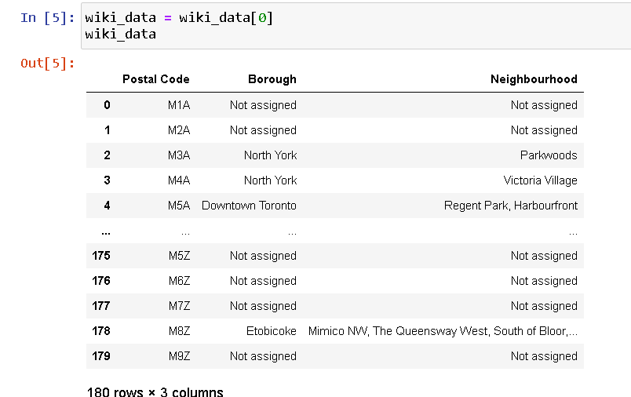
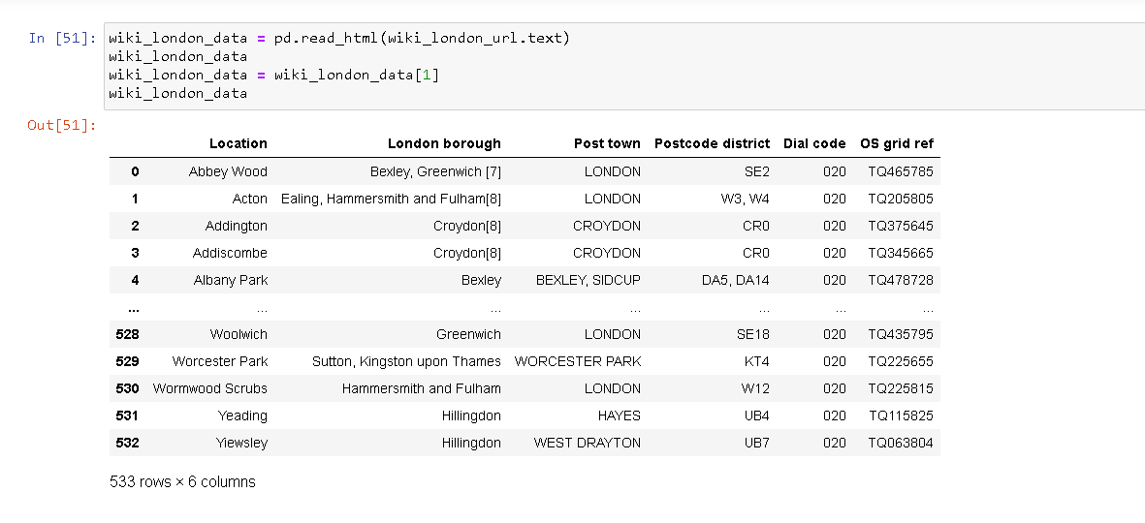
Methodology
The methodology performed for both the cities are similar thus helping us in the comparison
Importing the postal codes for each city using wikipedia

Slide 6
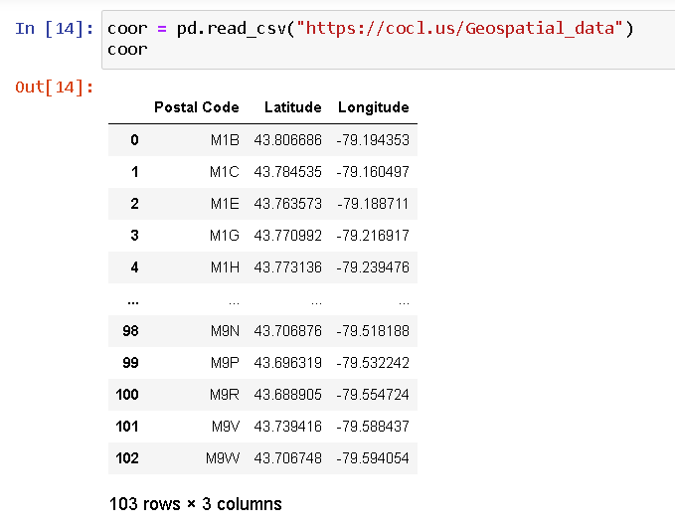
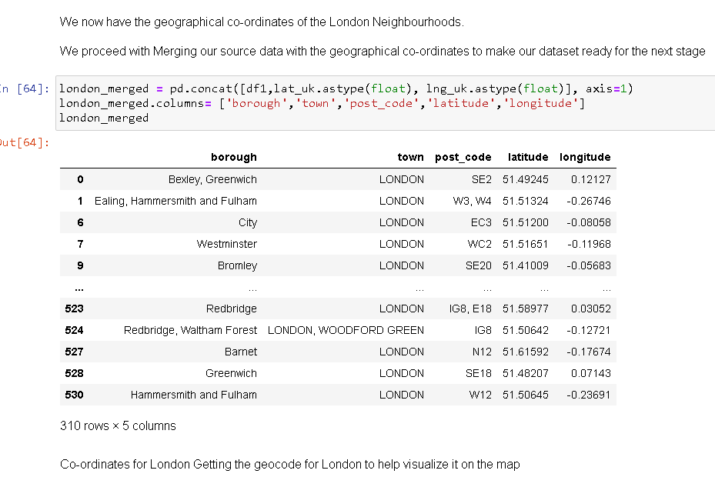
methodology
Locational data

Slide 7
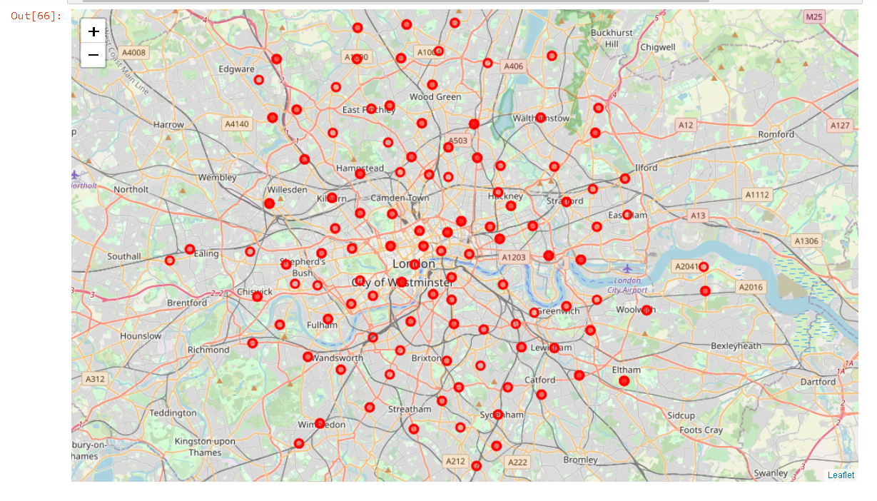
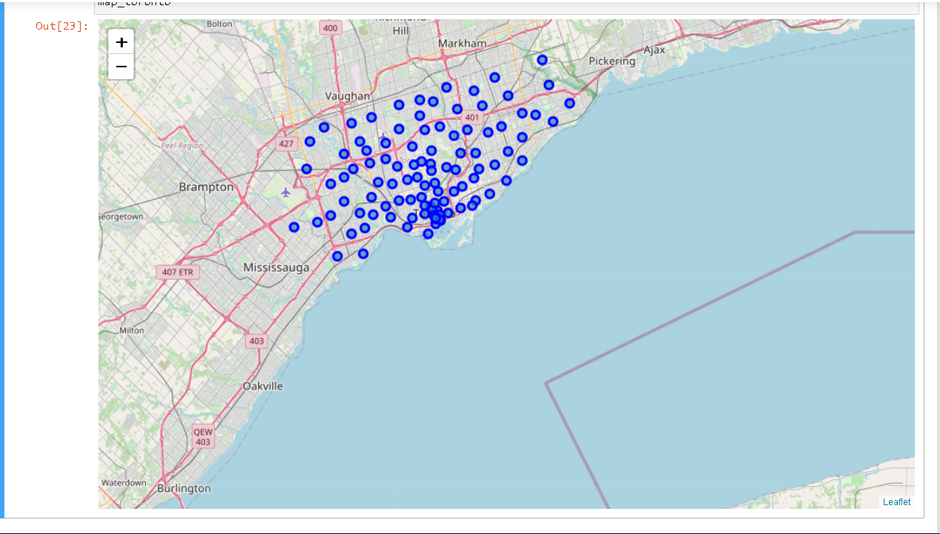
methodology
Plotting the neighbourhoods in the map. The first map is toronto and the subsequent map is london

Slide 8
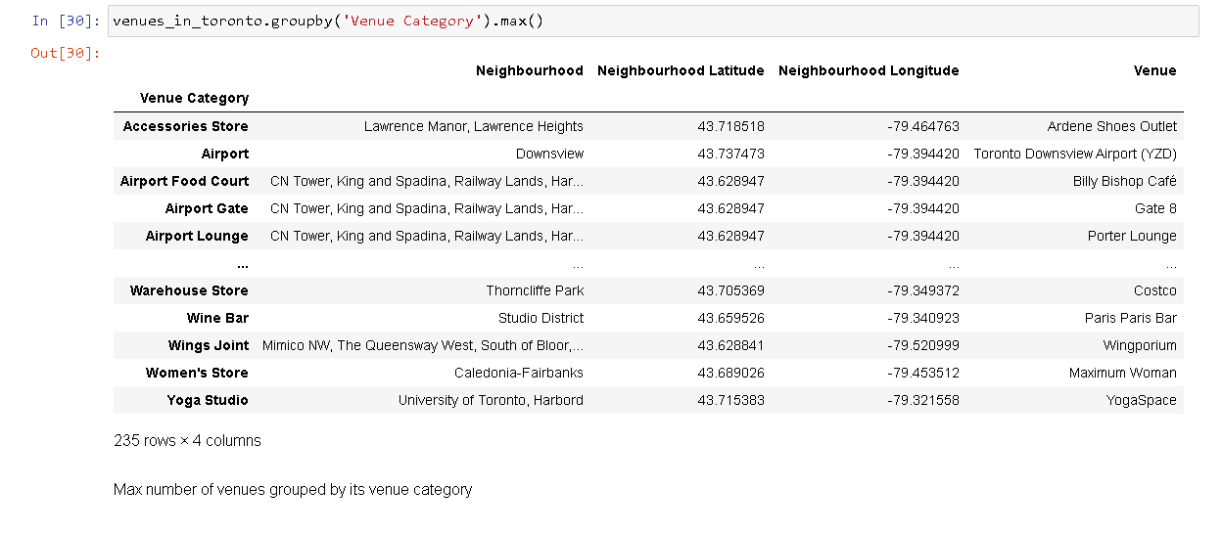
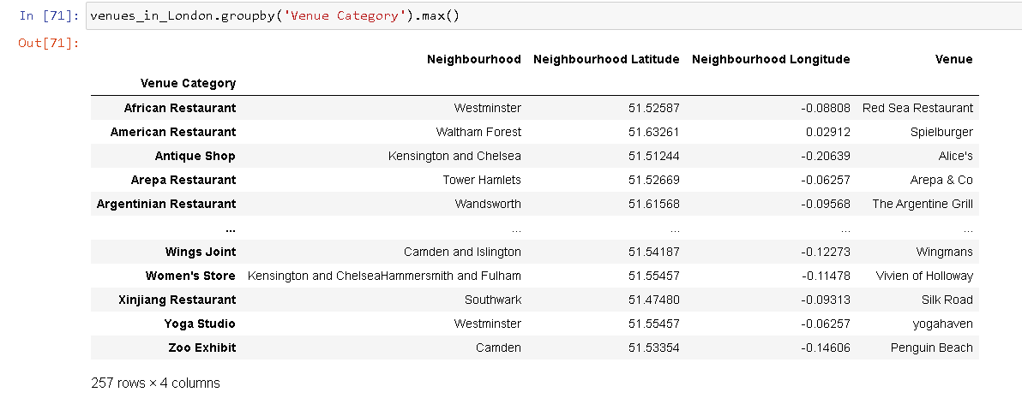
methodology
Grouping neighbourhoods by venues, the venues that we previously got using Foursquare API was used to group

Slide 9
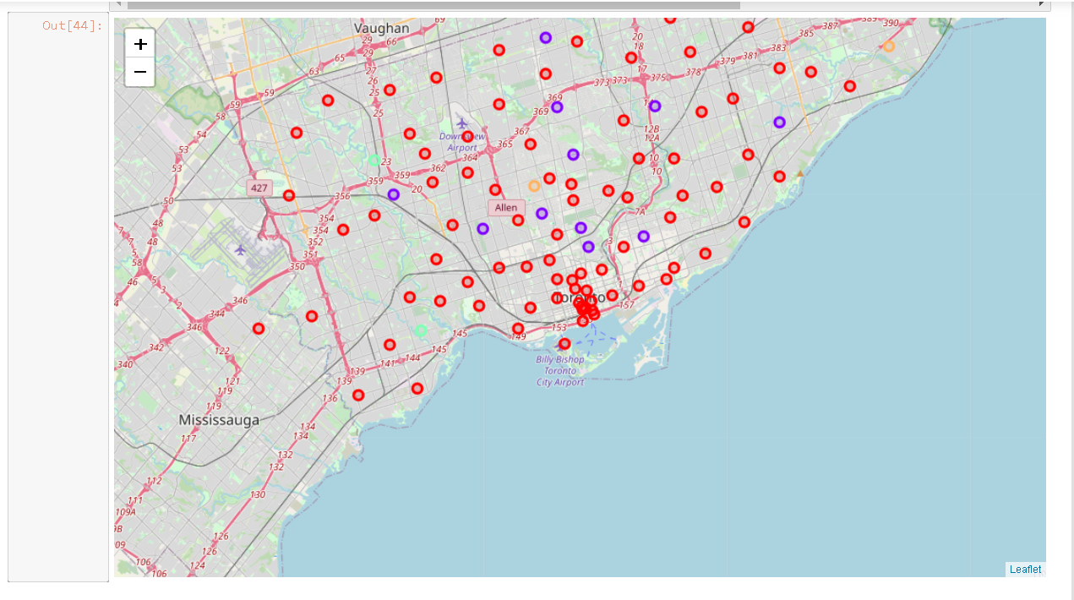
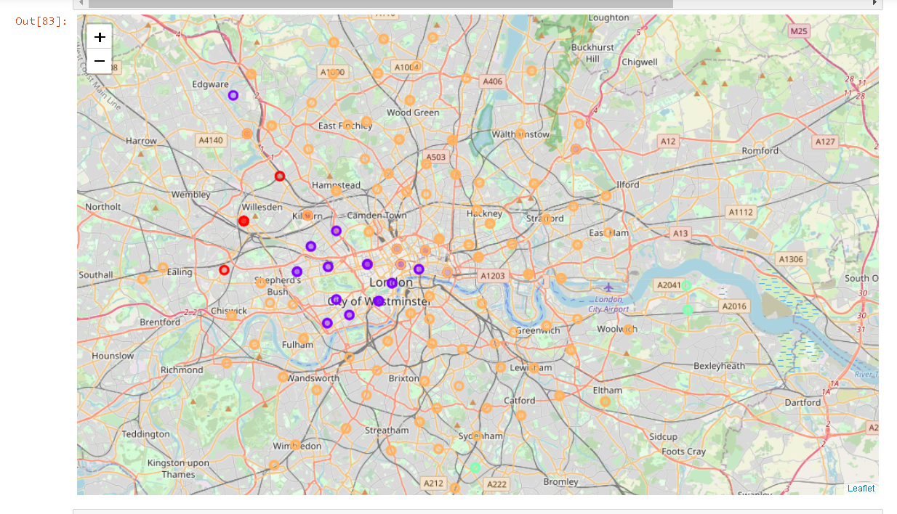
methodology
Cluster on Map

Slide 10
Result and Discussion
The neighbourhoods of London are very multicultural. There are a lot of different cuisines including Indian, Italian, Turkish and Chinese. London seems to take a step further in this direction by having a lot of Restaurants, bars, juice bars, coffee shops, Fish and Chips shops and Breakfast spots. It has a lot of shopping options too with that of the Flea markets, flower shops, fish markets, Fishing stores, clothing stores. The main modes of transport seem to be Buses and trains. For leisure, the neighbourhoods are set up to have lots of parks, golf courses, zoo, gyms and Historic sites. Overall, the city of London offers a multicultural, diverse and certainly an entertaining experience.
Toronto is comparatively smaller in area. Although due to the high migration rate we can see that Toronto is also multicultural and most of the immigrants are from India, China, Europe. Thus the cuisines are also similar to london. Toronto has a lot of pizza places, coffee shops, parks European restaurants, Vietnamese restaurants, Chinese restaurants, donut shops, drug stores.
The observations I made are that London seems to be a bigger city with more of a larger cultural diversity, Toronto comparatively seems more a more passive city with beautiful tourist spots too.

Slide 11
Conclusion
The purpose of this project was to explore the cities of London and Toronto to see how attractive it is to potential tourists and migrants. We explored both the cities based on their postal codes and then extrapolated the common venues present in each of the neighbourhoods finally concluding with clustering similar neighbourhoods together. We could see that each of the neighbourhoods in both the cities have a wide variety of experiences to offer which is unique in it's own way. The cultural diversity is quite evident which also gives the feeling of a sense of inclusion.

